Slide 1
ASP_PROJECT_2021 “Take-away”
By Di Falco Simon & Huygebaert Amandine

Slide 2
Statement
Create a web platform to enable a take-away system
Concerns several restaurants;
A restaurant owner lists his restaurant menus and dishes;
Home delivery possible;
The customer can create an account
The connected customer can order
A visitor can consult the menus without authenticating himself

Slide 3
Analysis
Thinking before you program
object-oriented language is complex
Define the scope of work with the client
COMMUNICATION !
Whit what?
UML language
Standard modeling language
Diagram
It exists thirteen diagram.
Three of them
Use case diagram, class diagram and sequence diagram.

Slide 4
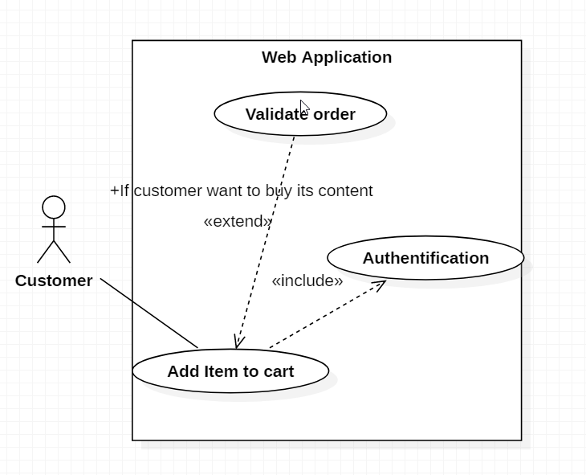
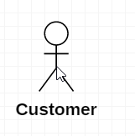
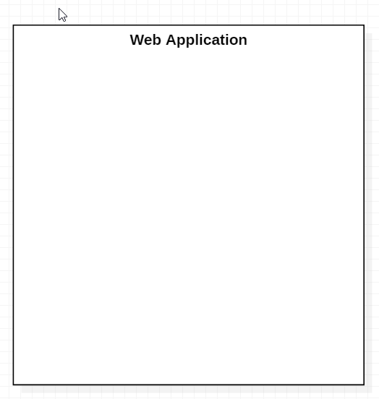

Use case diagram : theory
For what purpose?
Starting point
Presents the features clearly to the customer
How does it work ?
Include & extend case
Actor
System
Use case
« what can the actor do in the system? »
« Who use the system ? »
Not always humain !
« What is the project? »

Slide 5
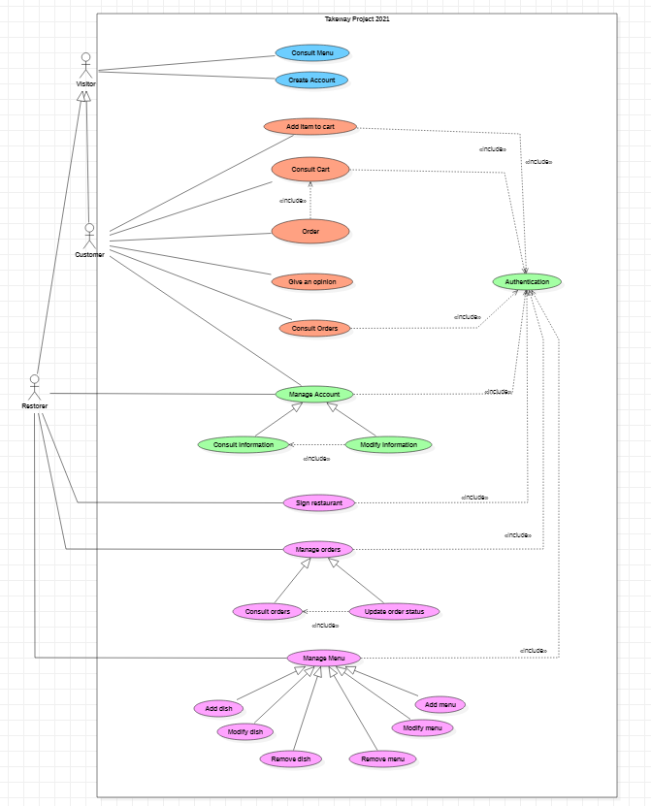
Use case diagram : our
Visitor
Customer
Restorer

Slide 6
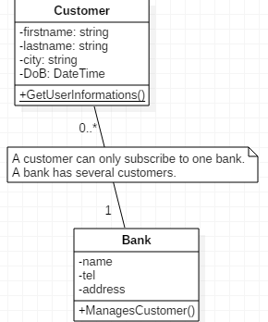
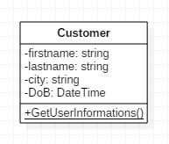
Class diagram : theory
For what purpose?
Models static classes and interfaces and the relationships between them.
How does it work ?
Class
Privates attributes
Static operation
Association

Slide 7
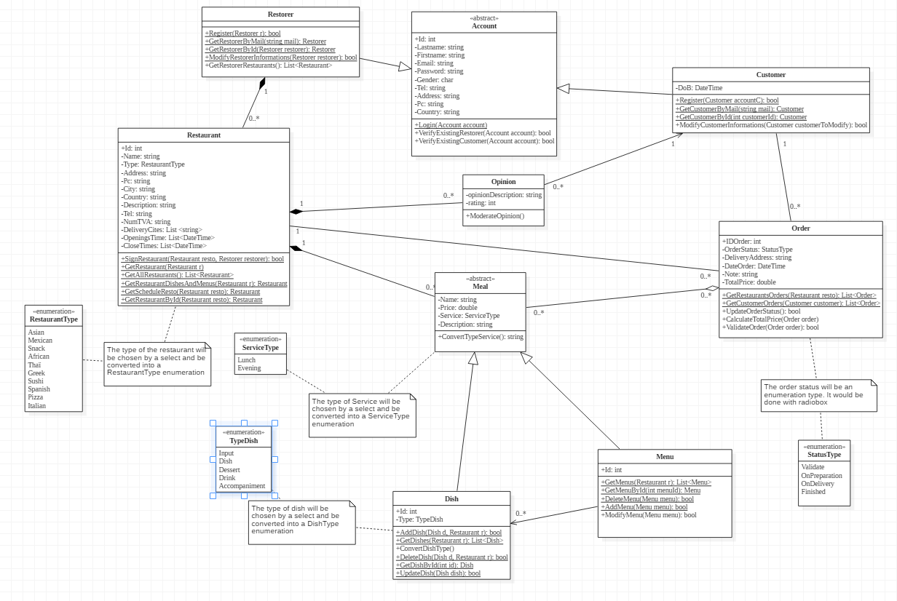
Class diagram : our
generalization and specification
Restorer and customer are account
Composition
The meals belong to the restaurant and if it is destroyed they are also
Aggregation
Order contains meals

Slide 8
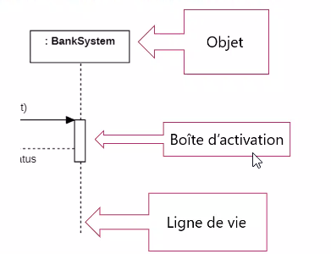
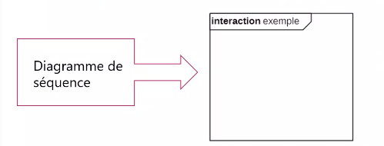
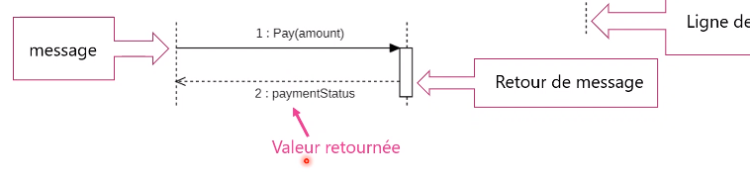
Sequence diagram : theory
Interaction diagram.
Shows the behavior of the system through the interaction between the objects that compose it.
The objects will create and interact with each other.
Shows the interactions of objects in a use case.
Object Activation box Lifeline
Diagram sequence
Dialog

Slide 9
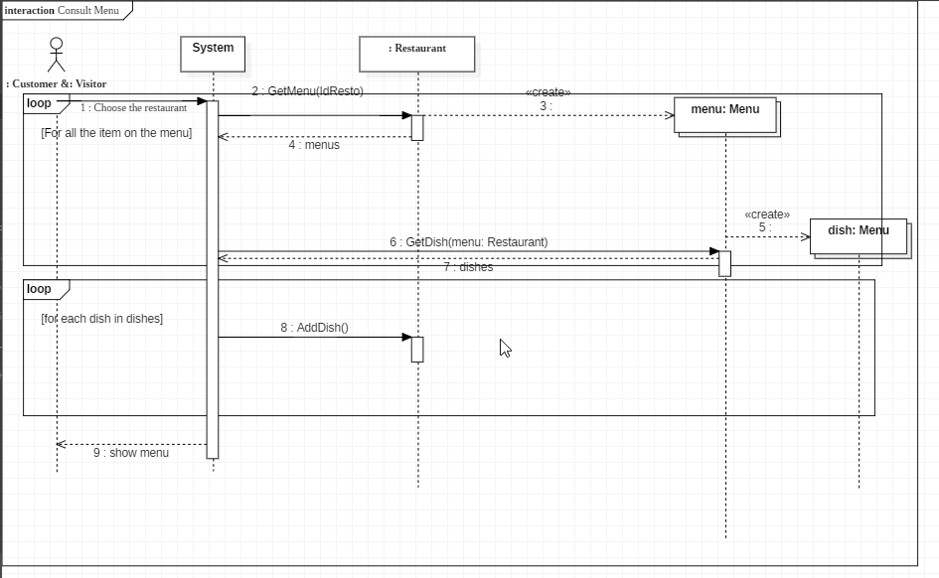
Sequence diagram : two of our own
(2)
(1)

Slide 10
Demo
Run ASP_PROJECT

Slide 11
Conclusion
Simon
Amandine
Difficult to grasp the object concepts;
Handles pressure badly;
we had a good communication;
I wanted to pass the project for August => discouraged

